Slide 1
Sad_Child
BOT
Prepared by:
Aleksandra Krivykh
Valentina Erpyleva

Slide 2
Assignment
Variant 2
A program for evaluating the child's play time on PC
01
Monitoring
02
Telegram bot
03
Turning off the PC
This program will allow the parent to track which applications are running on the child's computer.
There is no need to download a separate application, Telegram is required for the application to work
You can remotely turn off the child's computer if you don't like the processes running on his computer

Slide 3








Work Scheme
Sad_Child
Cloud
01
Check
02
Game is on
03
Turn off the PC
04
PC is off

Slide 4
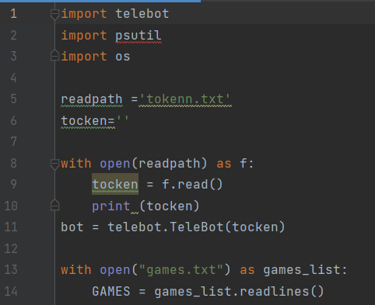
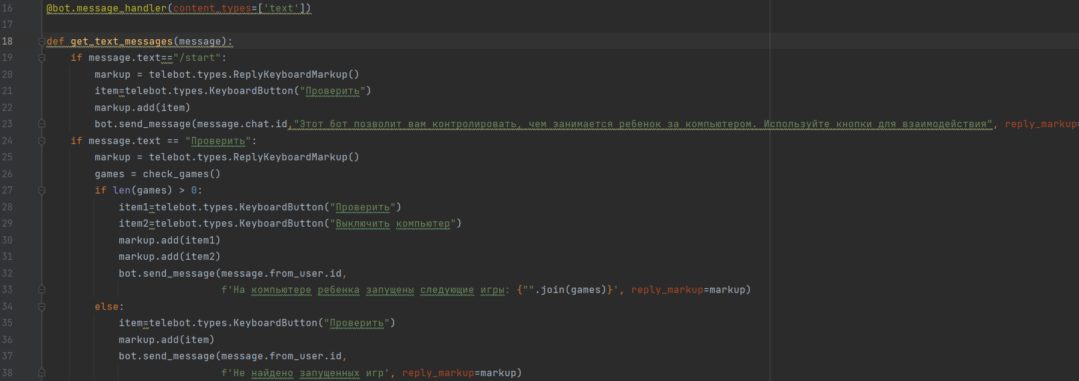
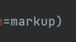
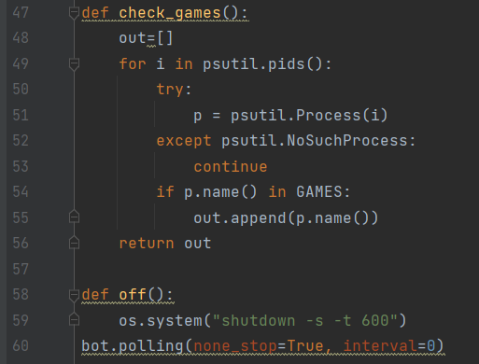
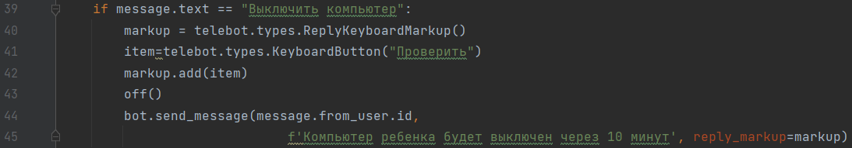
Code
Sad_Child

Slide 5
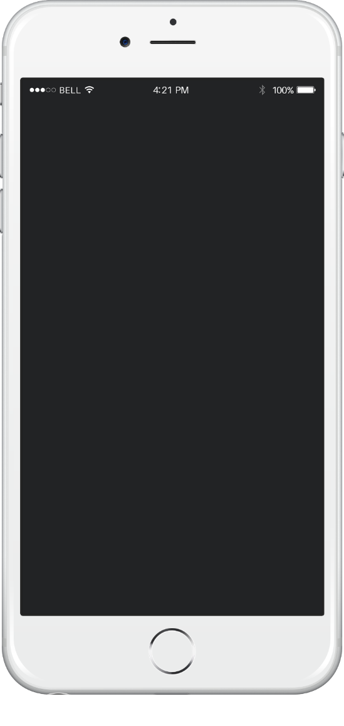
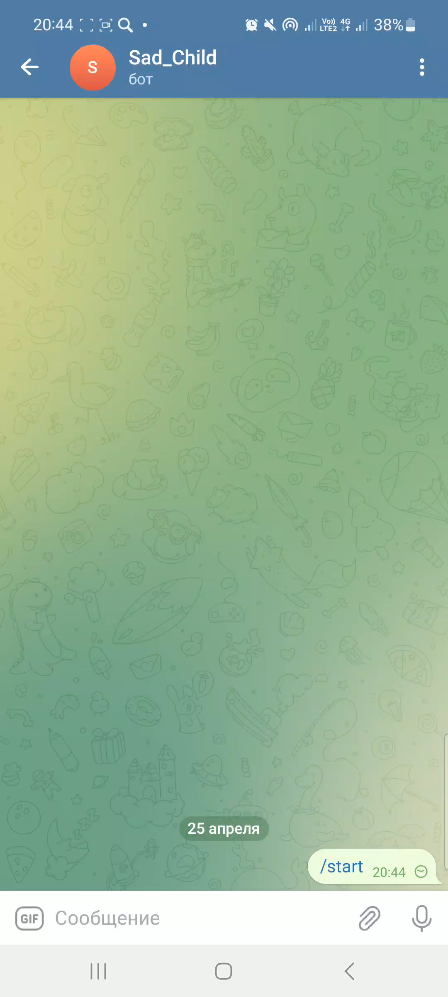
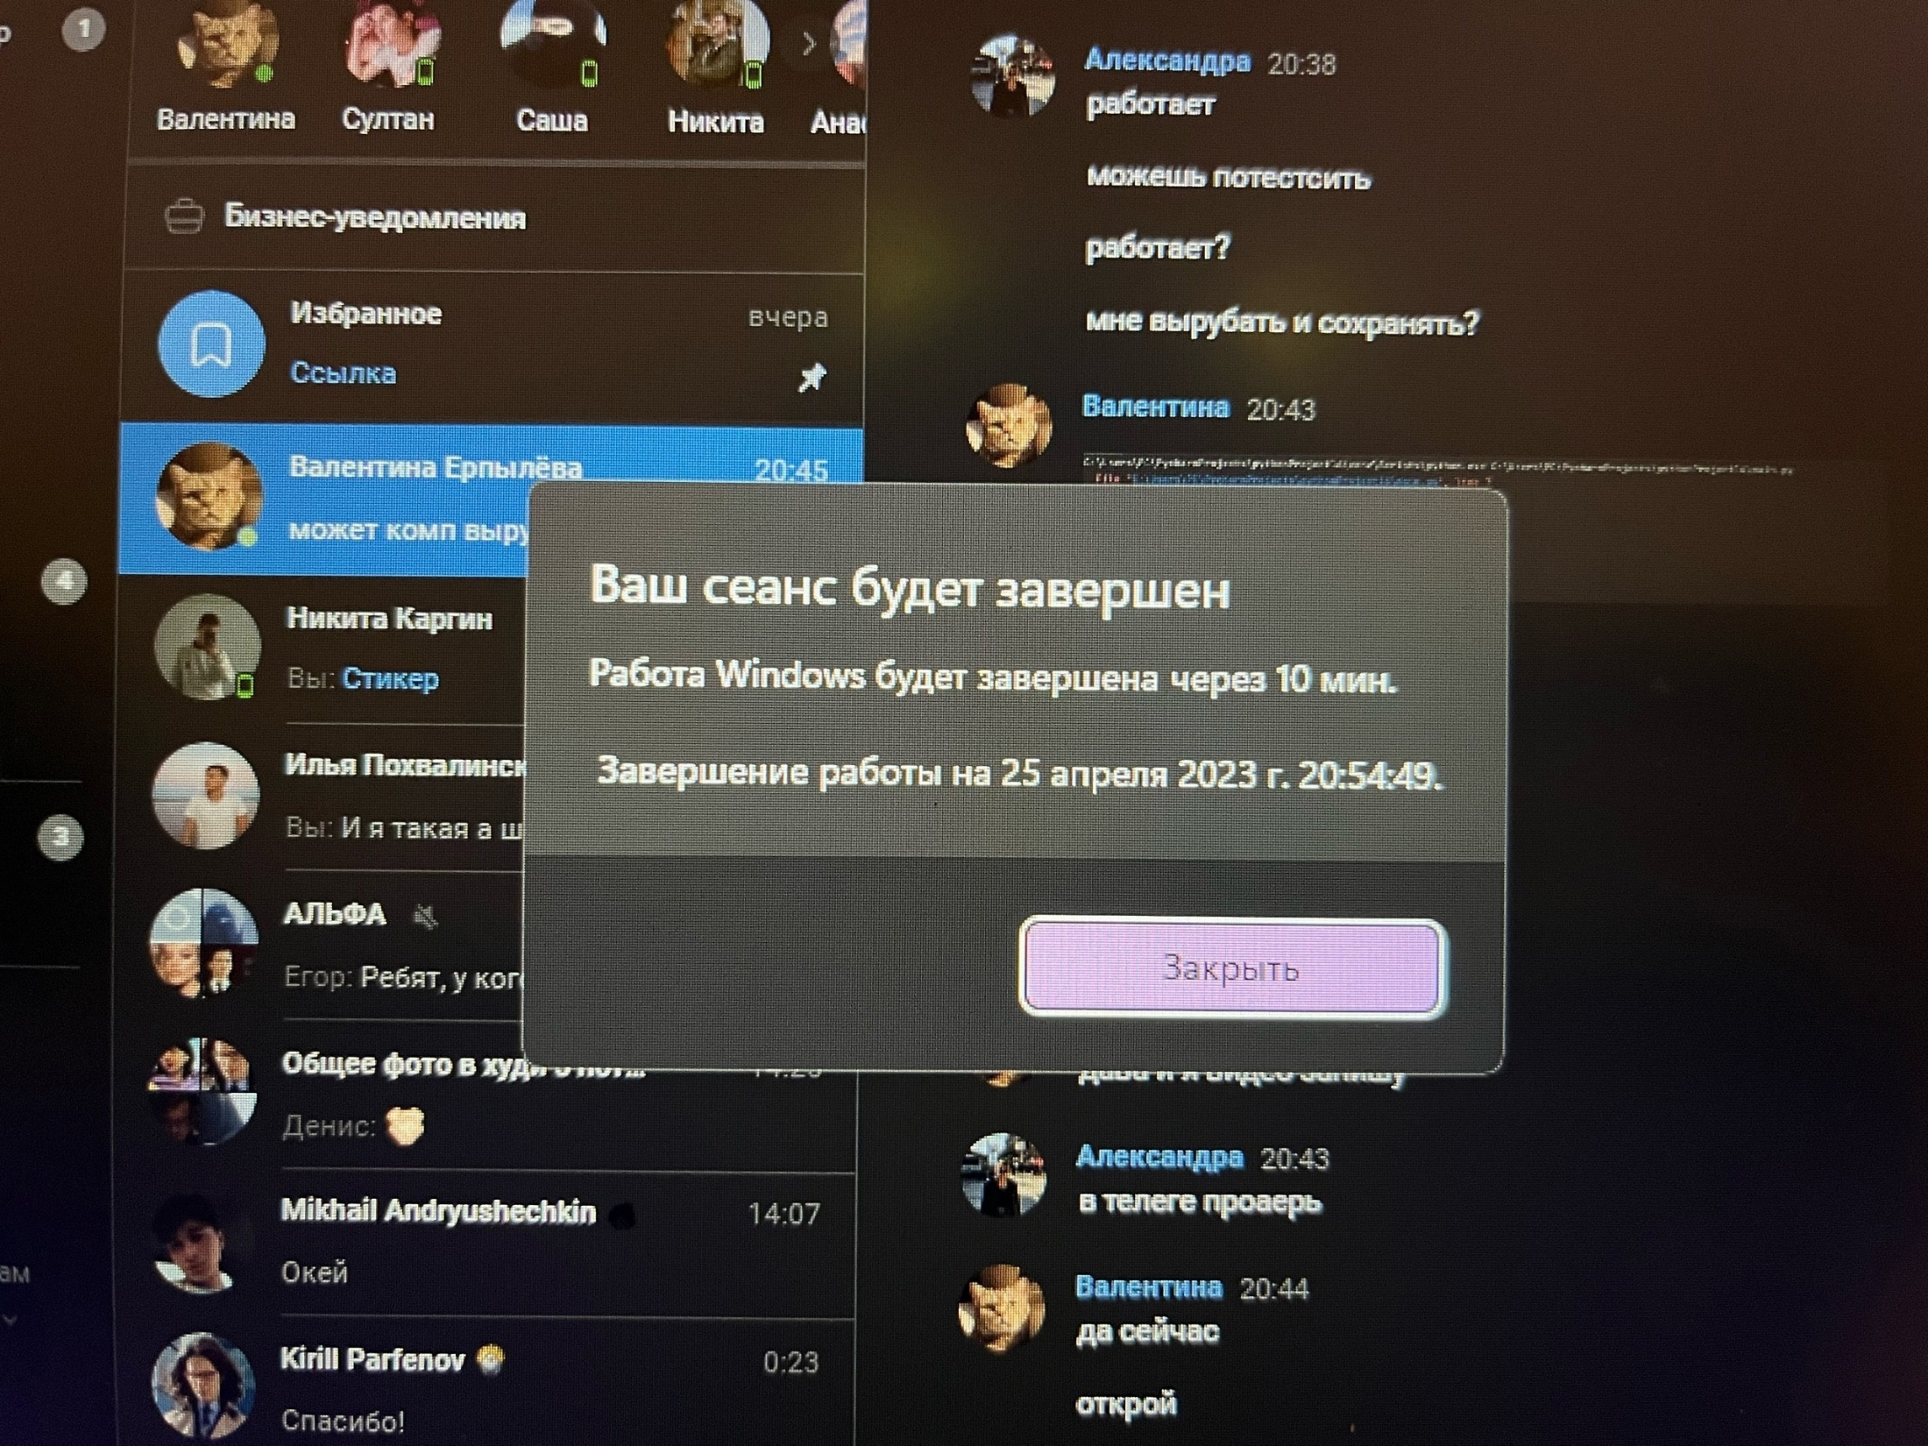
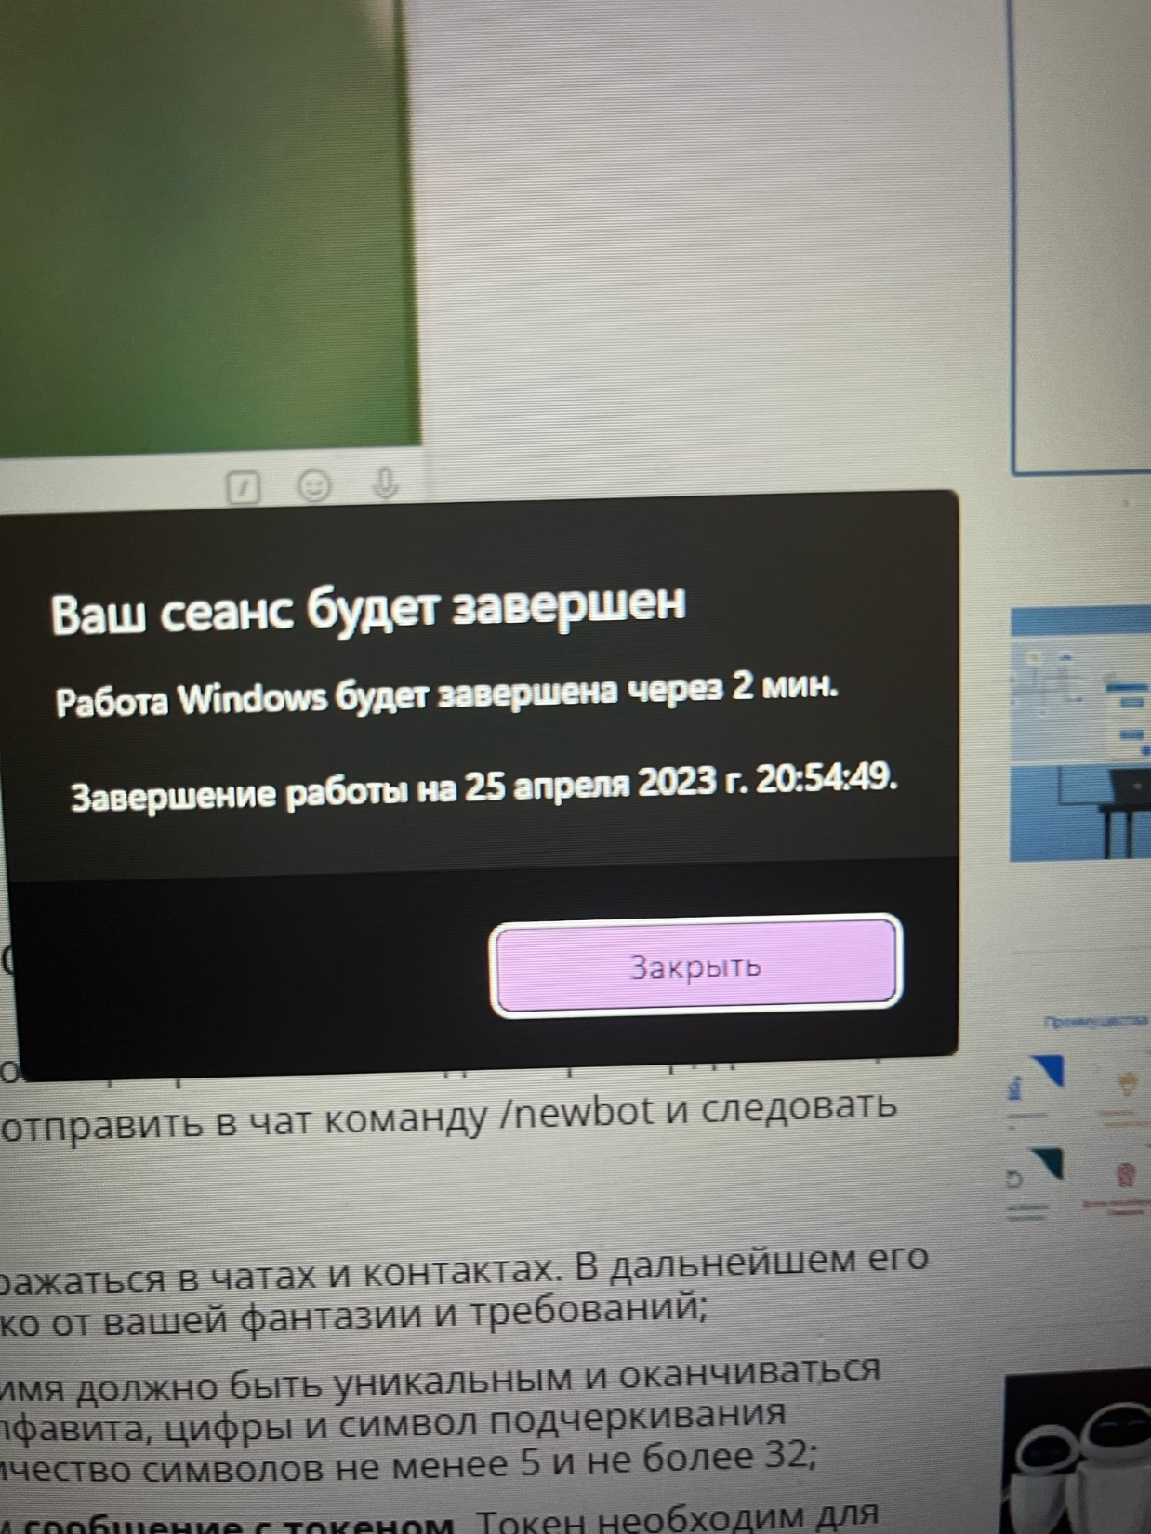
Example of work
What We’ve Done

